Slide 1
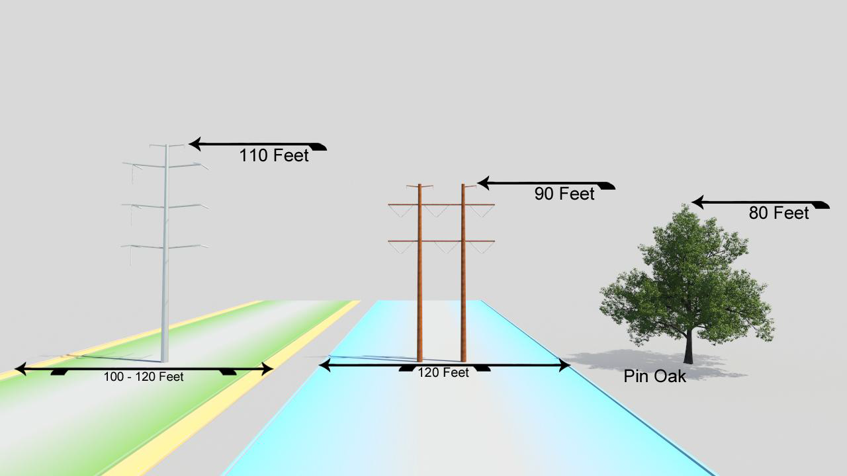
Proposed Structure Options for Railroad Route on HOA/PWC Easement

